Slide 1
Endometriosis
SIG Endocrinology 2019
Chairperson – Madhuri Patil

Slide 2
Endometriosis is a Major Health Problem Worldwide
Chronic, estrogen-dependent, inflammatory disorder
Present in >50% women with pelvic pain and infertility Chatman DL et al J Reprod Med 1982) (Goldstein DP et al J Reprod Med 1989) (Reese KA et al J Pediatr Adolesc Gynecol 1996
Affects >100 million women and teens worldwide
6.7-11 years from symptom onset to surgical diagnosis and treatment (Nnoaham et al 2011; Rogers et al, 2013)
Early diagnosis and treatment can reduce uncertainty of diagnosis, discomfort, disease progression, complications Ballard et al, 2006
Estimated U.S. costs for diagnosis, treatment, and QOL in 2009 = $69B (Simeons 2012; Burney & Giudice 2012)

Slide 3
Prevalence accuracy of Endometriosis
True prevalence
is unknown
(estimated 3 -10%)
Difficult to determine due to
diversity of symptoms
severity of symptoms
may be also asymptomatic
Correct diagnosis
only after surgery

Slide 4
General aspects of endometriosis prevalence
Multiparous women
- during Laparoscopic sterilization - 6-43%
- Fertile women - 5.2% (Verkauf BS J Flam Med Assoc 1987, 74:61)
When dysmenorrhoea - Incidence is 40 -60%
Teens with chronic pelvic pain Diagnosed by Laparoscopy - 69.6%
Infertile women x 10 risk – 20 - 40%
Polygenic, multifactorial mode of inheritance
Occurrence rate among 1º Relatives occurs in 6.9 % as compared to 1% non blood related control group

Slide 5
Risk Factors
Higher in Asians and blacks
Less in White Caucasians
(Sangi-Haghpeykar H et al Obstet Gynecol1995) (Missmer SA et al Am J Epidemiol 2004)
Women with
Early menarche
Short menstrual cycles
Volume and duration of menses is less consistent
More prone
(Matorras R et al Fertil Steril 1995)
Inversely related to BMI
(Hediger ML et al Fertil Steril 2005; Missmer SA et al Am J Epidemiol 2004) (Berube S et al Epidemiology 1998)
Endometriosis is still a enigma as its pathogenesis, prognosis, progression and prediction of response to therapy is still unclear

Slide 6
Development of endometriosis
Possible mechanisms
Presence of endometrial

Slide 7
Diagnosis
Laparoscopy - Gold Standard
Laparotomy
Confirm a positive laparoscopy/laparotomy by histology
Inconclusive: CA-125, History, Pelvic examination
TVS for ovarian endometrioma – cyst with ground glass echogenicity
Cystoscopy and proctosigmoidoscopy - to assess ureter, bladder and bowel involvement
? IL-8 & CEA
TVS is useful for identifying or ruling out rectal endometriosis
MRI to diagnose peritoneal endometriosis is not well established

Slide 8
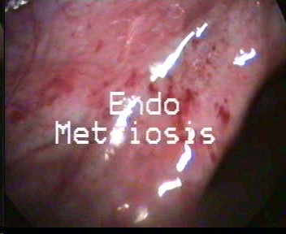
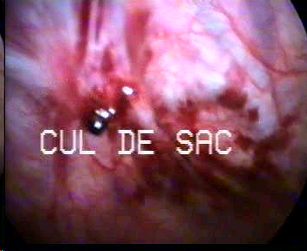
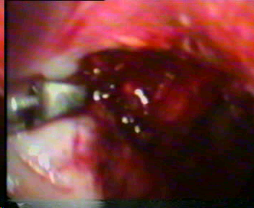
Classification / Staging
Several Proposed Schemes
Revised AFS System: Most Often Used
Ranges from Stage I (Minimal) to Stage IV (Severe)
Staging involves location, depth of disease & extent of Adhesions

Slide 9
Endometriosis Symptoms

Slide 10
Effect of Endometriosis on Fertility Mechanism
Distorted Pelvic Anatomy
Major pelvic adhesions that result from endometriosis
Impair oocyte release from the ovary or inhibit ovum capture or transport
Abnormal Uterotubal Transport
Reduction in physiologic uterotubal transport capacity
Endometriosis and Cytokines
Macrophage migration
Stromal cell adhesion to fibronectine
Extracellular matrix decay (MMP)
Endometrial cell proliferation
Angiogenesis
Altered Peritoneal Function
volume of peritoneal fluid with concentrations of PG, proteases, inflammatory cytokines - IL-1, IL-6,TNFa, and angiogenic cytokines - IL-8 and VEGF produced by macrophages
Elevated concentrations of inflammatory cytokines in serum imply that endometriosis may lead to systemic inflammation
An ovum capture inhibitor that prevents normal cumulus- fimbria interaction has been reported in the peritoneal fluid of hamsters with induced endometriosis
Concentration of transferrin, iron & alpha 2-HS glycoprotein elevated in peritoneal fluid
Detrimental to oocyte quality
Adversely affect sperm motility & survival
Transferrin attenuates FSH induced differentiation of granulosa cells contributing to ovarian dysfunction
Endocrine and Ovulatory Abnormalities
Luteinized unruptured follicle syndrome
LH receptor disorder
Luteal phase dysfunction
Abnormal follicular growth
Premature and multiple LH surges
Longer follicular phase
Lower serum estradiol levels and lower LH-dependent progesterone secretion during the luteal phase
levels of prolactin

Slide 11
Effect of Endometriosis on Fertility Mechanism
Endometriosis and Granulosa cell dysfunction
Lower level of LH receptors with decreased sensitivity to LH stimulation
Impaired steroid production (lower aromatase activity)
Higher apoptosis of granulosa cells
Lower VEGF gene expression
Alteration in cell cycle
Increase of oxidative stress markers
Higher expression of STS mRNA expression
In vitro granulosa cells secrete higher levels of IL‐1 beta, IL‐ 6,IL‐8, and TNF alpha
Follicular environment & endometriosis
Potential effects on oocyte quality
Altered progesterone and cytokine concentrations in follicular fluid
ATP Reduced oocyte viability
VEGF Decreased embryo development
TNF alpha Regulates apoptosis
Endothelin-l Inhibition of granulosa cell steroidogenesis
IL -10 Causes arrest in GO phase of GC
RANTES Increased inflammation, cytotoxic effects and OS
Oxidative stress in endometriosis results in
Impairment of
Granulosa cell function
Oocyte quality and function
Sperm integrity and function
Embryo integrity and development
Implantatio
High ROS results in
Meiotic spindle damage and poor oocyte quality
Intra follicular high concentration of ROS is associated with a high rate of degenerated oocytes

Slide 12
Effect of Endometriosis on Fertility Mechanism
Effect on oocyte and Embryo Quality
Incomplete maturation of ovarian follicle
Poor response with low oocyte quality
FR & IR – embryo toxic or anti-implantation effects
Immunological Explanation for Infertility
Autoantibodies against endometrial antigen & generalized polyclonal B-Cell result in autoimmune activation
Higher concentrations of anti-laminin-1 IgG prevent trophoblast proliferation & differentiation
Altered concentration & function of immune related cells ( concentrations of cytokines, growth factors & activated macrophages) in peritoneal fluid have adverse effect on sperm function & embryo survival
Higher apoptotic incidence, more alterations of cell cycle & higher incidence of oxidative stress
Poor quality early embryonic development
Embryo development slower compared to embryos derived from women with tubal disease
Abnormal phenotype on day 2
incidence of abnormal development – 3.5 to 15 times more frequent
2 PN with large peripheral regions of organelle depletion with or without darkened central cytoplasm
Arrested 2 PN with halo and anucleated fragments
2PN - abnormal cleavage of anucleated cytoplasm
Endometriotic fluid inadvertently incorporated into oocyte-cumulus complex at OR may have a negative effect on fertilization & implantation
Effect on Implantation
Poor embryo quality
Disorders of endometrial function
Reduced endometrial expression of avb3 integrin (a cell adhesion molecule) during the time of implantation
Very low levels of an enzyme involved in the synthesis of the endometrial ligand for L-selectin
Aberrant Genes expressed in Endometriosis can reduce IR by affecting endometrial receptivity

Slide 13
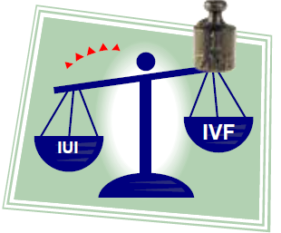
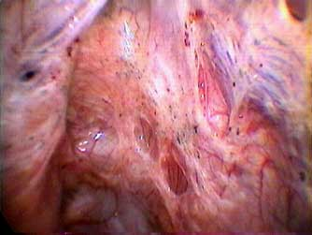
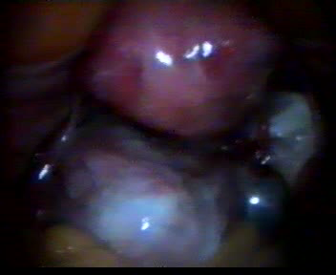
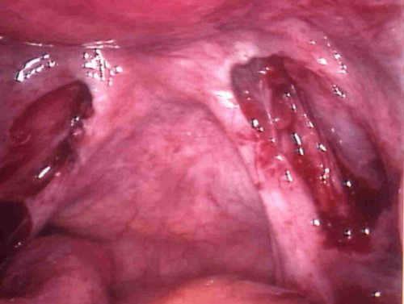
Women’s age
Presence and severity of pain
Grade of endometriosis
Desire for fertility
Need for treatment for infertility
Which Treatment to choose ?
Surgical
Medical

Slide 14
Treatment Options
Expectant/
Symptomatic
Ovarian suppression
Combinations of suppression and surgery
Surgery
COS
ART

Slide 15
Medical treatment of endometriosis-associated pain
ESHRE Guidelines
Counsel women with symptoms presumed to be due to endometriosis thoroughly, and to empirically treat them with adequate analgesia, combined hormonal contraceptives or progestagens (GPP)
Prescribe hormonal treatment (hormonal contraceptives, progestagens, anti-progestagens, or GnRH agonists as one of the options, as it reduces endometriosis-associated pain) (Grade A-B)
Take patient preferences, side effects, efficacy, costs and availability into consideration when choosing hormonal treatment for endometriosis-associated pain (GPP)
Prescribing a combined hormonal contraceptive may be benificial as it reduces endometriosis-associated dyspareunia, dysmenorrhea and non-menstrual pain (Grade B)
The continuous use of a combined oral contraceptive pill may be useful in women suffering from endometriosis-associated dysmenorrhea (Grade C)

Slide 16
GnRH-agonist treatment in Endometriosis
increase in natural killer-cell activity
increased antibody levels, resulting in higher peritoneal fluid levels of IL-1 and decreased levels of TNF-a
also affect cell apoptosis and obliterate the embryotoxic effects of peritoneal fluid
→ Suppression of ovarian function ineffective to improve fertility (Grade A)
effective for relieving pain associated with endometriosis
there is no evidence that it improves fertility

Slide 17
Use of GnRH Analogs in Patients With Endometriosis
Advantages of GnRHa therapy are maximized during the time of greatest disease suppression
Must be used immediately before IVF–ET and is associated with higher PRs and increased IRs
Patients with stage III or IV endometriosis who were subjected to GnRHa therapy 6 months before their IVF–ET cycle showed a 30% increase in PRs per cycle compared with patients who had undergone a standard COS
Surrey ES et al Fertil. Steril. 78(4), 699– 704 (2002)
Dicker D et al Fertil. Steril. 57(3), 597–600 (1992)

Slide 18
Surgical Treatment Of Endometriosis-associated Infertility
→ uncertain, whether surgery improves infertility (Grade B)
In infertile women with AFS/ASRM stage I/II endometriosis, clinicians should perform operative laparoscopy (excision or ablation of the endometriotic lesions) including adhesiolysis, rather than performing diagnostic laparoscopy only, to increase ongoing pregnancy rates (Grade A)
Infertile women with ovarian endometrioma undergoing surgery, clinicians should perform excision of the endometrioma capsule, instead of drainage and electrocoagulation of the endometrioma wall, to increase spontaneous pregnancy rates (Grade A)
When performing surgery in women with ovarian endometrioma, clinicians should perform cystectomy instead of drainage and coagulation orCO2 laser vaporization as it reduces endometriosis-associated pain (Grade A)
Concerns of surgery are Recurrence rate and decreased Ovarian reserve
Clinicians should not prescribe preoperative hormonal treatment to improve the outcome of surgery for pain in women with endometriosis (Grade A)
Clinicians clearly distinguish adjunctive short-term (< 6 months) hormonal treatment after surgery from long- term (> 6 months) hormonal treatment; the latter is aimed at secondary prevention (GPP)

Slide 19
Choosing the Best Surgical Techniques to enhance fertility
Laparoscopy is the gold-standard treatment for ovarian endometriomas
Various techniques include
cystic wall laser vaporization
drainage and bipolar coagulation of the cystic wall
endometrioma stripping
Surgery can lead to a reduction in OR by three main mechanisms:
1.excessive stripping of the ovarian cortex
2.use of bipolar coagulation to stop bleeding
3.presence of surgery-induced inflammation
CO2 laser causes significantly less damage to the ovary than electrocoagulation as it is more
precise
accurate
less detrimental to adjacent healthy ovarian tissue
Laparoscopic cystectomy reduces ovulation rates but maintains a normal pregnancy rate per ovulation
Ovarian response to GT drops after surgical Rx for ovarian endometrioma
Incidence of POF higher with bilateral endometrioma Rx

Slide 20
Surgery prior to treatment with ART in women with peritoneal endometriosis
Recommendation
In infertile women with AFS/ASRM stage I/II endometriosis undergoing laparoscopy prior to treatment with assisted reproductive technologies, clinicians may consider the complete surgical removal of endometriosis to improve live birth rate, although the benefit is not well established (Opoien, et al., 2011). | Grade C Low quality
ESHRE Endometriosis Guidelines September 2013

Slide 21
Surgery prior to treatment with ART in women with ovarian endometrioma
Recommendation | Grade
In infertile women with endometrioma larger than 3 cm there is no evidence that cystectomy prior to treatment with ART improves pregnancy rates (Benschop, et al., 2010, Donnez, et al., 2001, Hart, et al., 2008) | A
In women with endometrioma larger than 3 cm, the GDG recommends clinicians only to consider cystectomy prior to ART to improve endometriosis-associated pain or the accessibility of follicles | GPP
The GDG recommends that clinicians counsel women with endometrioma regarding the risks of reduced ovarian function after surgery and the possible loss of the ovary. The decision to proceed with surgery should be considered carefully if the woman has had previous ovarian surgery | GPP
ESHRE Endometriosis Guidelines September 2013

Slide 22
Recommendations in case of recurrence ovarian endometrioma
IVF : first choice
< 5 cm, unilateral ?
Patients age
combined male pathology
GnRha down regulation
Re operation
in case of cysts larger 5 cm
Bilateral pain
But
Reduces ovarian reserve
Recurrence is possible

Slide 23
Medically Assisted Reproduction in Endometriosis
In infertile women with AFS/ASRM stage I/II endometriosis, clinicians may perform intrauterine insemination with controlled ovarian stimulation, instead of expectant management, as it increases live birth rates (Grade C)
Recommended to use of ART for infertility associated with endometriosis, especially if tubal function is compromised or if there is male factor infertility, and/or other treatments have failed (GPP)

Slide 24
Lower FR, PR
Higher Abortion rate
Response to COH
Lower response
Higher dose of GT required
Poor response – 27 %
Low number of oocyte recovery due to
1.Technical difficulties at OR due to ovarian adhesion
2.Ovarian endometriosis affect follicular recruitment
3.Cytokines specific to endometriosis affects ovarian response to medications
Surgery may involve removal of normal ovarian cortex, depleting the number of germ cells and reducing ovarian reserve (Oktay et al., 2001; Martin and O’Conner, 2003)
After a laparoscopic excision of bilateral endometrioma incidence POF is 0.6−6.8% (Busacca et al., 2006)
Incidence higher with repeated ovarian surgery in recurrent and severe endometriosis
Surgery can also impair the blood supply to the ovaries (Busacca et al., 2006; Reich and Abrao, 2006)
Ovulation occurs less frequently on the operated sites (La Torre et al., 1998; Loh et al., 1999; Candiani et al., 2005)
Fertility preservation was first reported in a young woman with endometriosis in 2007 (Elizur et al., 2007)

Slide 25
Role of Lifestyle in Infertile Patients With Endometriosis
Endometriosis is an estrogen-dependent disease, so any lifestyles that production of E2 may reduce the risk of endometriosis
Correlation between BMI and the risk of developing endometriosis is still controversial in literature
Regular exercise lowers estrogen levels and may benefit women with endometriosis
Caffeine and alcohol both increase estrogen levels, and thus the risk of endometriosis
MissmerSA, et al Am. J. Epidemiol. 160(8),784–796 (2004)
Bates GW, et al Fertil.Steril. 38(4),406–409 (1982)
Dale E, et al .Obstet.Gynecol.54(1),47–53(1979.

Slide 26
Smoking and Endometriosis
Inverse relationship between smoking and endometriosis
Incidence of endometriosis was lower in women who started smoking at a younger age (<17 years) and smoked more than one pack a day than those who began later in life and smoked less frequently
This is because smoking has been found to lower estrogen levels
Cramer DW, et al.Ann.NYAcad.Sci.955,11–22; (2002); Cramer DW, et al JAMA 255(14), (1986)

Slide 27
Diet and Endometriosis
Positive association between endometriosis and red meat consumption noted
Negative association between endometriosis and fruit and vegetable consumption
Parazzini F, .Hum.Reprod.19(8),1755– 1759 (2004)
Increased risk of endometriosis with the consumption of palmate acid, a major component of animal fat
Missmer SA, et al Hum. Reprod. 25(6),1528–1535 (2010)
Increased risk with high consumption of trans-fats; however, consumption of omega-3 fatty acids reduced this risk
No relation between total fat intake and endometriosis

Slide 28
Secondary Prevention Of Disease and Painful Symptoms
There is a role for prevention of recurrence of disease and painful symptoms in women surgically treated for endometriosis
For an endometrioma (≥3 cm), clinicians should perform ovarian cystectomy, instead of drainage and electrocoagulation, for the secondary prevention of endometriosis-associated dysmenorrhoea, dyspareunia and non-menstrual pelvic pain.
After cystectomy in women not immediately seeking conception, clinicians are recommended to prescribe combined OCP for the secondary prevention of endometrioma
In women operated on for endometriosis, recommended to prescribe post-operative use of a LNG-IUS or a combined OCP for at least 18 – 24 months, as one of the options for the secondary prevention of endometriosis-associated dysmenorrhoea, but not for non-menstrual pelvic pain or dyspareunia.
The choice of intervention depends on patient preferences, costs, availability and side effects

Slide 29
Endometriosis
Main Symptoms
Pain
Infertility
Mild to Moderate
Moderate to severe
Laparoscopy
No residual disease
Moderate , non adhesive residual disease
Severe or residual adhesive disease
diagnosis by laparoscopy
Ablation of lesion in the same sitting
Medical Therapy
Progestins
antiprogesterone
GnRH Analogues
GnRH Antagonists
Danazol
Recurrence
Medical Therapy for 3 months
NO change
COCs (empirical treatment)
Evaluate after 6 months
if no improvement
GnRH agonist
Oophorectomy if family is complete
Natural Cycle for 3 months
OI+IUI for 3 months
OI+IUI for 3-4 cycles
GnRH agonist for 3 months
Laparoscopy ablation of residual disease
Poor prognosis
Good Prognosis
IVF
OI+IUI 3 cycles

Slide 30
Changes associated with endometriosis may affect
Take home Message -------
Ovulation and corpus luteum function
Oocyte quality
Oocyte capture
Sperm transport and function
Fertilization
Embryo development
Implantation

Slide 31
Take home Message -------
Endometriosis has no pathognomonic signs or symptoms and is therefore difficult to diagnose
No satisfactory therapy for all patients with endometriosis
Currently, the therapies for endometriosis are controversial because they can improve pain and infertility but they do not cure the disease
Poor understanding of pathophysiology leads to difficulty in coping with, treating and understanding this disease
Endometriosis remains one of the most perplexing diseases for patients, physicians and researchers

